Slide 1
World Happiness Project
Frontier Tech Leaders Programme Global Cohort 1
Mehr Ali Qasimi
12-10-2023

Slide 2
Outlines
Frontier Tech Leaders Programme Global Cohort 1
Overview
Dataset
Exploratory Data Analysis (EDA)
Data Preparation and Feature Engineering
Machine Learning Model
Deployment
Future Work

Slide 3
Background
Frontier Tech Leaders Programme Global Cohort 1
The key factors considered in the rankings include economic factors, social support, health, freedom to make life choices, generosity, and perceptions of corruption.
The report ranks countries based on a "Happiness Score," which is a composite measure of the factors mentioned above. Nordic countries like Finland, Denmark, Norway, and Iceland have consistently ranked high in recent reports, countries like Afghanistan, Lebanon, Zimbabwe, congo are suffering unhappiness or bad life.

Slide 4
Objectives
Frontier Tech Leaders Programme Global Cohort 1
The primary goal of the World Happiness Report is to provide a comprehensive understanding of well-being and happiness on a global scale. It aims to promote policies that improve the quality of life for people around the world.
It emphasizes the significance of happiness as a fundamental human goal, aiming to move beyond traditional economic indicators and offer a holistic perspective on societal well-being

Slide 5
SDG Relation
Frontier Tech Leaders Programme Global Cohort 1
The connection between the World Happiness Project (or similar initiatives) and the SDGs lies in the recognition that well-being and happiness are important dimensions of sustainable development. Here are some ways in which they relate:
Quality of Life (SDG 3): Goal 3 of the SDGs focuses on ensuring healthy lives and promoting well-being for all at all ages.
Economic Growth and Social Support (SDGs 1, 8, 10): Happiness is often influenced by economic factors, social support systems, and reduced inequalities. These aspects are addressed in SDGs such as No Poverty (SDG 1), Decent Work and Economic Growth (SDG 8), and Reduced Inequalities (SDG 10).
Peace, Justice, and Strong Institutions (SDGs 16, 17): Happiness and well-being are closely linked to the presence of peace, justice, and strong institutions. These are key components of Sustainable Development Goals 16 (Peace, Justice, and Strong Institutions) and 17 (Partnerships for the Goals).

Slide 6
Dataset
Frontier Tech Leaders Programme Global Cohort 1
The primary source of the dataset for World Happiness 2023 is Kaggle, a renowned platform for machine learning datasets and competitions. This dataset provide new and complete necessary for training and evaluating the machine learning model.
The World Happiness Report is an annual publication by the United Nations Sustainable Development Solutions Network. It ranks countries based on various factors related to well-being and happiness. The factors typically include GDP per capita, social support, life expectancy, freedom to make life choices, generosity, and perceptions of corruption.

Slide 7
Data Collection
This dataset consist of every countries happiness report and their reasons which are more effected the people to live happy and sad in their countries. And also it shows the top happiest and sad countries in all the world, it shows every country happiness levels based on the scores they got.
This dataset data are collected by experts and organizations who work in this fields to solve people living and life problems.

Slide 8
Exploratory Data Analysis (EDA)
Frontier Tech Leaders Programme Global Cohort 1

Slide 9
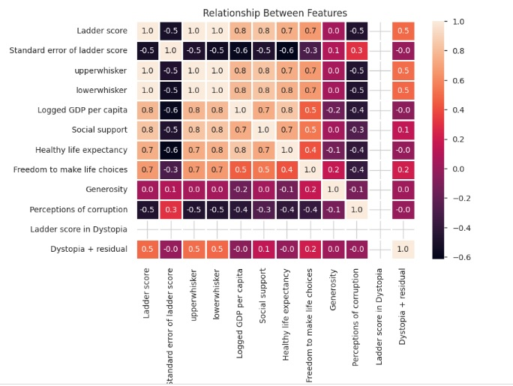
Data Preprocessing
For cleaning and preprocessing data of World Happiness I have removed the missing or NAN values, Scaled the data, Used LabelEncoding to encode the data, removed columns unnecessary names or renamed columns, founded the correlation of different features in dataset.

Slide 10
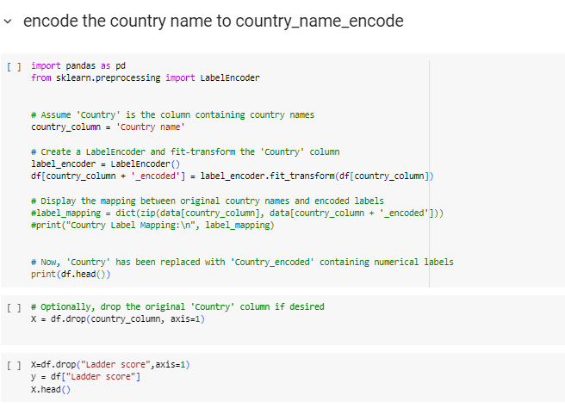
Frontier Tech Leaders Programme Global Cohort 1

Slide 11
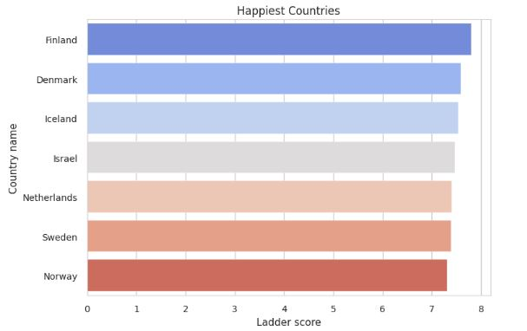
Frontier Tech Leaders Programme Global Cohort 1

Slide 12
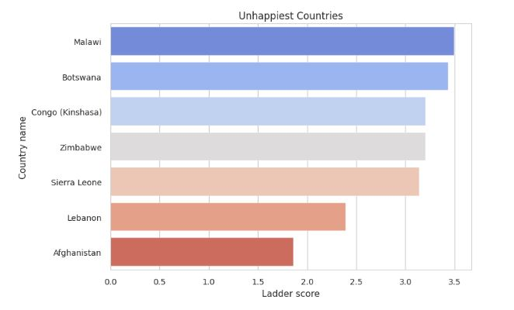
Frontier Tech Leaders Programme Global Cohort 1

Slide 13
4. Machine Learning Models
Frontier Tech Leaders Programme Global Cohort 1

Slide 14
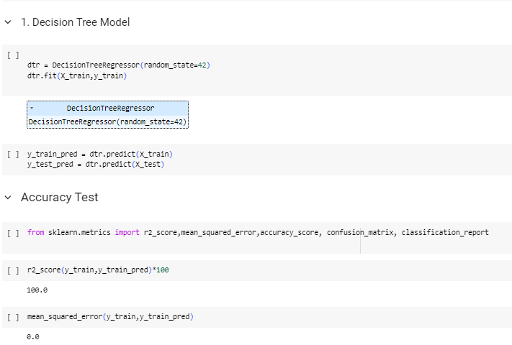
4.1 Model Selection and Training
Frontier Tech Leaders Programme Global Cohort 1
I have used different models for training the world happiness dataset this algorithms or models are such as Decision Tress, Random Forest, SVM, Linear Regression and also XG Boost but there was different prediction or output for each algorithm.
Ex:

Slide 15
Validation and Hyperparameter Tuning
Evaluation metrics and visualizations
Highlight the model's performance
Details on any hyperparameter tuning performed and Impact on model performance

Slide 16
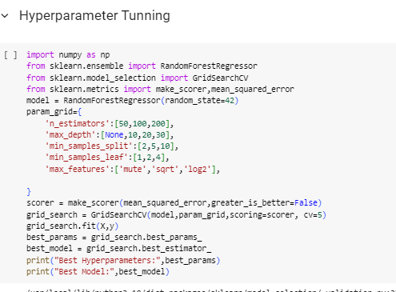
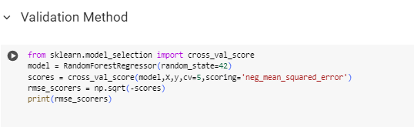
Results

Slide 17
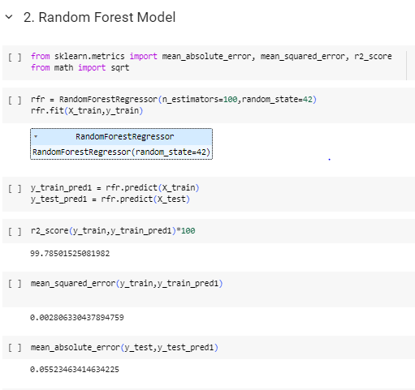
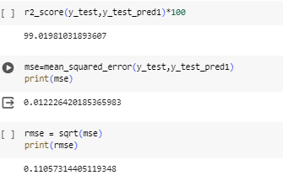
Results
After using all various types of models i found that Random forest model is working so good for this dataset

Slide 18
Deployment
Frontier Tech Leaders Programme Global Cohort 1
Prepare Machine learning model
Deploy using flask
model.ipynb (ML model)
model.pkl (pickle file for ML model)
app.ipynb (flask application)
index.html (template)
whr2023.csv (data to build ML model)

Slide 19
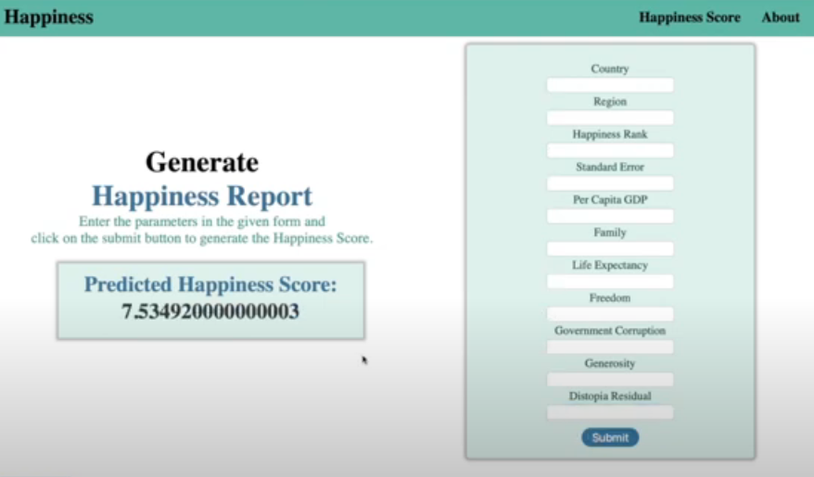
Frontier Tech Leaders Programme Global Cohort 1

Slide 20
6. Future Work
Frontier Tech Leaders Programme Global Cohort 1
Making prediction more accurate.
Finding stakeholders for the project to support and deploy the project.
Using new models or algorithms for having the best result.

Slide 21
References
Frontier Tech Leaders Programme Global Cohort 1
EASTERLIN, RICHARD A. 1974. Nations and Households in Economic Growth Does Economic Growth Improve the Human Lot? Some Empirical Evidence.
Helliwell, John F., and Robert D. Putnam. 2004. “The Social Context of Well-Being.” Philosophical Transactions of the Royal Society B: Biological Sciences 359(1449): 1435–46.
Helliwell, John F, Richard Layard, and Jeffrey D Sachs. 2023. “The Happiness Agenda: The Next 10 Years.” World Happiness Report: 166. https://happiness-report.s3.amazonaws.com/2023/WHR+23.pdf.
Lyubomirsky, Sonja, Laura King, and Ed Diener. 2005. “The Benefits of Frequent Positive Affect: Does Happiness Lead to Success?” Psychological Bulletin 131(6): 803–55.
B. Rowan, Andrew N. 2023. “World Happiness Report 2023 Mar 29 , 2023 World Happiness Report 2023.” 5(3).

Slide 22


Thank you!
Frontier Tech Leaders Programme Global Cohort 1

